Slide 1
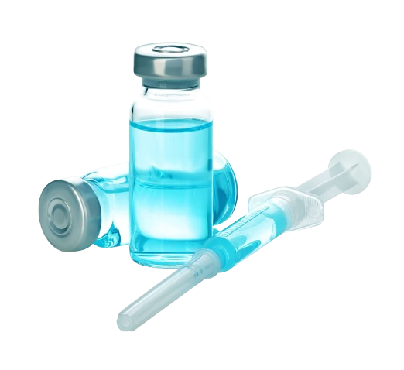
Personalized Medicine at Pfizer
Leveraging Data Analytics for Enhanced Drug Development and Patient Care

Slide 2

Problem Statement
Highlight Pfizer's objective to enhance personalized medicine.
Emphasize the need to understand demographic and genetic factors affecting drug efficacy and side effects.
Background
Discuss advancements in genomics and precision medicine.
Benefits of analyzing clinical trial and genomics data:
Tailored drug development
Reduced trial-and-error in prescribing
Improved patient outcomes

Slide 3

Project Scope
Objective:
Identify demographic, genetic, and clinical factors influencing drug efficacy.
Optimize treatment plans and clinical trials.
Data Sources:
Clinical trial and genomic datasets.
Demographic, medical history, and drug performance metrics.
Methodology
Data Wrangling:
Cleaning, handling missing values, merging datasets.
Analysis Techniques:
Correlation studies between genetics and drug efficacy.
Side effect pattern identification.
Visualizations of progression-free survival rates.

Slide 4
Goals & KPIs
Understand demographic/genetic influences on drug efficacy.
Patterns in side effects by patient subgroup.
Optimize survival rates and clinical trial design.
Key outcomes:
Increased trial efficiency.
Targeted treatment plans.

Slide 5
Recommended analysis
Side Effects by Drug
Drug C exhibits the highest frequency of side effects across all categories.
Drug D demonstrates the lowest frequency of side effects.
Nausea is the most common side effect across most drugs, followed by dizziness and fatigue.
Success Rate by Gender
Females have the highest success rate, followed by males and then other genders.
Gender | Success Rate (%)
Male | 31.1
Female | 60.4
Other | 34.25

Slide 6
Recommended analysis
Average Dose Administered by Drug
Drug A has the highest average dose administered.
Drug | Average Dose
Drug A | 42.96
Drug B | 34.33
Drug C | 29.33
Drug D | 29.0
Gender Breakdown of Participants
Males constitute the majority of participants, followed by other genders and then females.
Male | 51.1
Female | 20.1
Other | 28.8

Slide 7
Recommended analysis
Drug Efficacy: Drug D shows the highest efficacy score (5.56), followed by Drug A (5.51), Drug C (5.27), and Drug B (5.27).
Success Rate: The success rate increases with each trial phase, reaching its highest point in Phase IV.
Survival Rate: Survival rates are generally lower for Drug B and Drug C compared to Drug A and Drug D.
Progression-Free Survival: There's a downward trend in progression-free survival across the drugs, with Drug B showing the lowest rate.
Adverse Events: The number of adverse events appears to decrease with age.

Slide 8
Recommended analysis
Gene Expression Level vs. Survival Rate
Certain genes (HER2, BRCA2, EGFR, TP53, and BRCA1) correlate with varying survival rates.
This highlights the importance of genetic factors in predicting patient outcomes, with HER2 and BRCA1 showing significant survival rates.
Trial Phases: Later phases yield higher success rates.
Genetic Influence: Genetic profiles strongly impact survival rates.
Age Factors: Age significantly affects success rates and may necessitate tailored treatment approaches.
Comparative Effectiveness: Notable differences in survival and progression-free rates suggest the need for ongoing evaluation of drug efficacy.

Slide 9
Recommendations
Focus on effective and low side-effect treatments.
Address gender and ethnic diversity gaps in trials.
Explore underrepresented genetic markers and age groups.
Conclusion
Personalized medicine's impact on drug development.
Benefits for patients, researchers, and stakeholders.

Slide 10
THANK YOU
Project Owner: Khushaboo Nehete
Email:khushaboojawale@gmail.com

